Slide 1
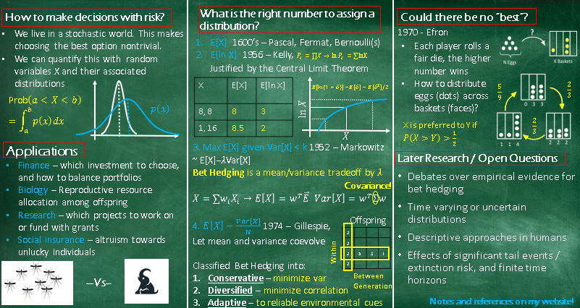
Notes:
Yellow = write in live.
Given the time constraint, I have to decide between going in more depth on one thing, or less depth on many, I’m always interested in more breadth, so I’

Slide 2

How to make decisions with risk?
What is the right number to assign a distribution?
Could there be no “best”?
What if fitness is relative not absolute?
Efron (statistician) concrete formulation
Bio low survival then harsh competition
If it was transitive, 033 should beat 114
But this only happens 4/9 of the time.
We have a rock-papers-scissors dynamic
Also works for multiplayer, any digraph.
Might object to payoff, [2,2,2] > [1,1,99999999], but doesn’t need strict threshold or independent rolls
Either due to non determinism from quantum mechanics or imperfect information, the future state of the world is uncertain. This makes decisions nontrivial, as any action could have a range of consequences.
History of answers to this question.
We know how to compare numbers, so it would suffice to compress the distribution.
Actuarial / insurance: CLT - temporal through sequential bets or spatial through concurrent, either must be independent
Problem: resource often grow multiplicatively
Kelly (bell labs information theory) solved for the bet proportion that maximizes growth rate = information rate.
The explanation for this difference is the variance an average (squared) deviation from E[X].
Geometric intuition: variance is symmetric by log is not, +1 vs +1%.
Variance is bad, how to co-optimize with E[X]?
Markowitz (economist) Computed the efficient set of RV. Tradeoff locally looks linear by LaGrange multipliers
This “Modern portfolio theory” won 1990 economics Nobel prize.
Doesn’t gave a resolution, like saying which vector is longer, there is a range of answers based on tradeoff.
Gillespie (biologist) pins down a lambda.
Phenotypic variance (diversity) reduces aggregate fitness variance.
Applications
Later Research / Open Questions
All examples of the same abstract problem: how to distribute resources (money or effort) among uncertain endeavors (investments, offspring, research projects).
Each distribution creates a random variable – the portfolio performance.
Diversified BH vs plasticity/parental effects, microbes experiments fast evolution environment control.
We assumed the only source of uncertainty was the inherent stochasticity, and no uncertainty in the distribution. It is costly to reduce uncertainty in the distribution e.g. in clinical trials. This creates an Explore-exploit tradeoff, investigated by learning theories.
Prospect theory explains biases (risk aversion or seeking). Kahneman received the 2002 Nobel Prize in economics for this. Also Allais paradox.
Notes:
Yellow = write in live.
Given the time constraint, I have to decide between going in more depth on one thing, or less depth on many, I’m always interested in more breadth, so I’

Slide 3
Subsequent Research and open questions
Debates over empirical evidence for bet hedging – hard to distinguish from ordinary plasticity, constraint, parental effects, or unmeasured adaptation. Examples in desert annuals and then microbes for fast evolution / exact control of environment.
What if we don’t have perfect knowledge of the random variable's distribution? This talk assumed there was no uncertainty in the RV. This makes a meta question, as the RV itself has a distribution now. Regret based approaches robustness… also related to learning / MAB literature (Gittin’s, UCB, Boltzmann) dynamic experiments (clinical trials) and pricing.
Non-static distribution or distribution of distributions? Can collapse down – just a higher dimensional policy? State / Markov decision processes.
Descriptive approaches in humans – Prospect theory in humans to explain biases like risk aversion (or seeking in the case of gambling) Kahneman received the 2002 Nobel Prize in economics for this, Allais paradox, some non-transitivity from poor cognition? 1944 Von Neumann and Morgenstern proved rational preferences, by some reasonable definition, must use expected utility.
Effects of significant tail events / extinction risk (or finite time) / finite population effects e.g. CVaR[X]
Notes:
Relates to Blotto Game XXX from those slides – a question of resource allocation in a competitive environment, not really risk.
2022 – Yakio Yasui paper? Meaningful?
Decision theory?
Variance is symmetric – a problem if asymmetric up and downside.
Temporal vs spatial variation Martin 2019 and kokko’s environmental grain.
Could also care about median, or Expected utility
Bet-hedging strategies in expanding populations – martin 2019
“bacterial persistence, antimicrobial resistance, immune evasion, and cancer cell heterogeneity.” – e.g. variations in antibiotic treatment, AAABBBAAABBB vs all one.
LEARNING THEORY / STOCHASTIC CONTROL – of BH populations.
“Donaldson-Matasci, Bergstrom, and Lachmann developed a framework linking environmental uncertainty, phenotypic diversity, cue reliability, and the fitness value of information. “
Summary – the best distribution depends what is the thing you want to maximize – one shot or long term sum – E[X], some notion of risk – include var, long term product – log, if thresholds are important, could use min or conditional value at risk.

Slide 4
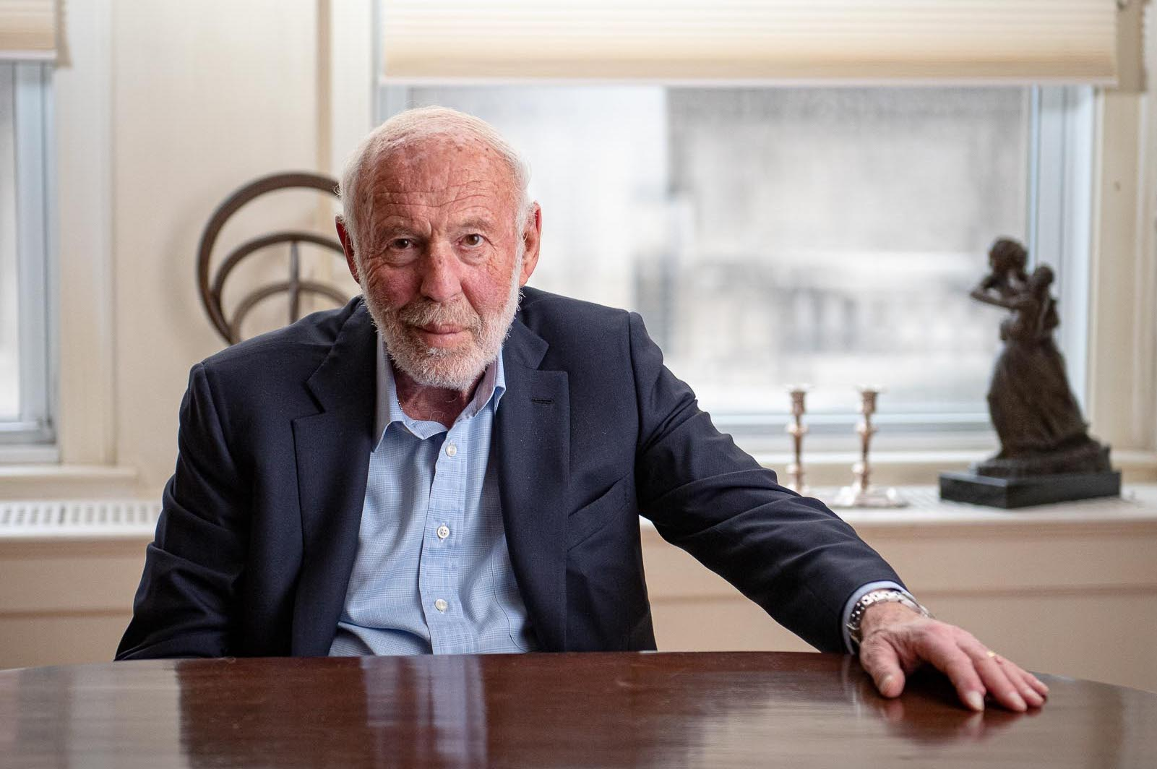
Jim Simons: mathematician made multi-millionaire
Mathematician who founded Renaissance Technologies, as of passing had about 30 billion dollars.
Founded the Simons foundation, major US funder of math research.
Notes:
Born in newton MA.

Slide 5
References
Markowitz, Harry. "Modern portfolio theory." Journal of Finance 7.11 (1952): 77-91.
Kelly, John L. "A new interpretation of information rate." the bell system technical journal 35.4 (1956): 917-926.
Gillespie, John H. "Natural selection for within-generation variance in offspring number." Genetics 76.3 (1974): 601.
Gardner, M. ``Mathematical Games: The Paradox of the Nontransitive Dice and the Elusive Principle of Indifference.'' Sci. Amer. 223, 110-114, Dec. 1970.
Olofsson, Helen, Jörgen Ripa, and Niclas Jonzén. "Bet-hedging as an evolutionary game: the trade-off between egg size and number." Proceedings of the Royal Society B: Biological Sciences 276.1669 (2009): 2963-2969.
Starrfelt, Jostein, and Hanna Kokko. "Bet‐hedging—a triple trade‐off between means, variances and correlations." Biological Reviews 87.3 (2012): 742-755.
Schreiber, Sebastian J. "Unifying within-and between-generation bet-hedging theories: an ode to JH Gillespie." The American Naturalist 186.6 (2015): 792-796.
Angel, Davis, 2017 “A Direct Construction of Nontransitive Dice Sets”
Notes:
Komisarski 2021 gives an upper limit for the lower bound on the winning edges in an N length cycle. Nontransitive Random Variables and Nontransitive Dice

Slide 6
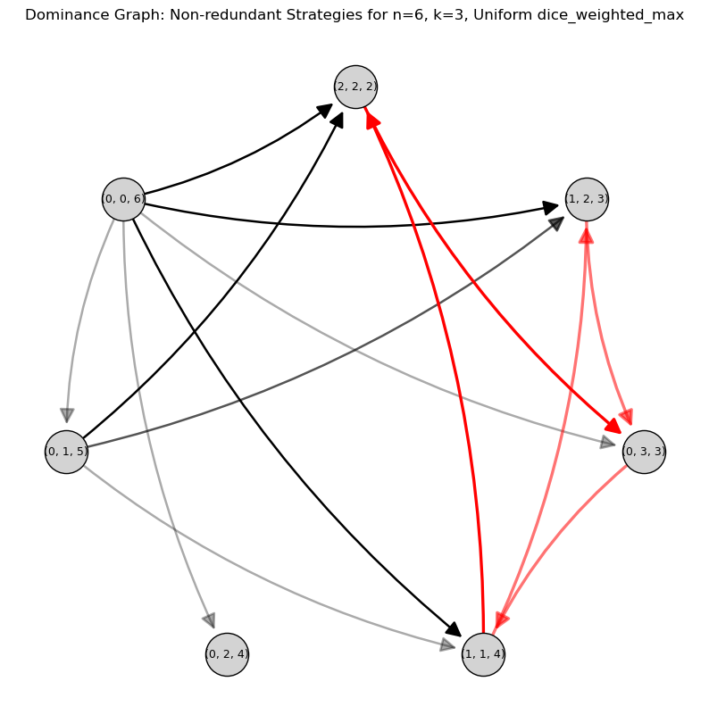
Extras
To the right we see the dice payoff graph for all ways of putting 6 eggs into three baskets, sorted clockwise from the top by outdegree (~overall strength). Indeed we see [0,0,6] the all in one is worst, and [2,2,2] is generally the best.

